Slide 1
Chapter 9 Objects and Classes

Slide 2
Objectives
To describe objects and classes and use classes to model objects (§9.2).
To use UML graphical notation to describe classes and objects (§9.2).
To demonstrate how to define classes and create objects (§9.3).
To create objects using constructors (§9.4).
To access objects via object reference variables (§9.5).
To use the Java library classes Date, Random, and Point2D (§9.6).
To distinguish between instance and static variables and methods (§9.7).
To define private data fields with appropriate get and set methods (§9.8).
To encapsulate data fields to make classes easy to maintain (§9.9).
To develop methods with object arguments and differentiate between primitive-type arguments and object-type arguments (§9.10).
To store and process objects in arrays (§9.11).
To create immutable objects from immutable classes to protect the contents of objects (§9.12).
To determine the scope of variables in the context of a class (§9.13).
To use the keyword this to refer to the calling object itself (§9.14).

Slide 3
OO Programming Concepts
Object-oriented programming (OOP) involves programming using objects.
An object represents an entity in the real world that can be distinctly identified. For example, a student, a desk, a course.
An object has a unique identity, state, and behaviors.
The state of an object consists of a set of data fields (also known as properties) with their current values.
The behavior of an object is defined by a set of methods.

Slide 4
Classes
Classes are constructs that define objects of the same type.
A Java class uses variables to define data fields and methods to define behaviors.
Additionally, a class provides a special type of methods, known as constructors, which are invoked to construct objects from the class.

Slide 5
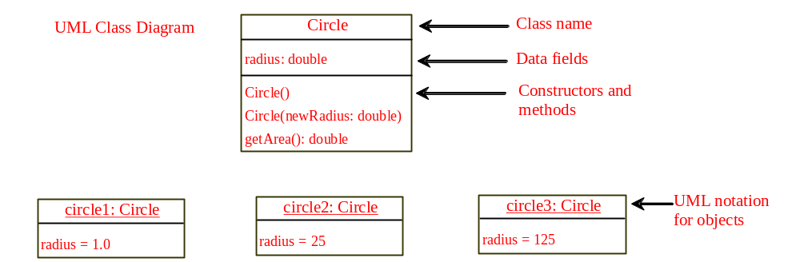
UML Class Diagram

Slide 6
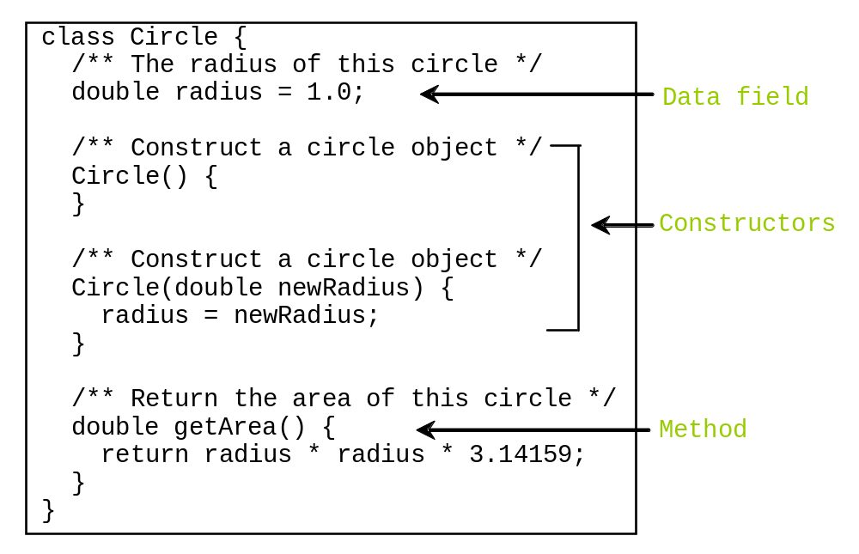
Classes

Slide 7

Example: Defining Classes and Creating Objects
Objective: Demonstrate creating objects, accessing data, and using methods.
Animation
TestSimpleCircle
Run

Slide 8
Caution
Recall that you use
  Math.methodName(arguments) (e.g., Math.pow(3, 2.5))
to invoke a method in the Math class.
Can you invoke getArea() using SimpleCircle.getArea()? The answer is no. All the methods used before this chapter are static methods, which are defined using the static keyword. However, getArea() is non-static. It must be invoked from an object using
  objectRefVar.methodName(arguments) (e.g., myCircle.getArea()).

Slide 9
Constructors
Circle() {
}
Circle(double newRadius) {
radius = newRadius;
}
Constructors are a special kind of methods that are invoked to construct objects.
A constructor with no parameters is referred to as a no-arg constructor.
Constructors must have the same name as the class itself.
Constructors do not have a return type—not even void.
Constructors are invoked using the new operator when an object is created. Constructors play the role of initializing objects.

Slide 10
Default Constructor
A class may be defined without constructors.
In this case, a no-arg constructor with an empty body is implicitly defined in the class.
This constructor, called a default constructor, is provided automatically only if no constructors are explicitly defined in the class.

Slide 11
Default Constructor Example
class Circle2 {
private double radius;
Circle2(double newRadius)
{
radius = newRadius;
}
/** Return the area of this circle */
double getArea() {
return radius * radius * Math.PI;
}
/** Return the perimeter of this circle */
double getRadius() {
return radius;
}
/** Set a new radius for this circle */
void setRadius(double newRadius) {
radius = newRadius;
}
}
public class Test {
public static void main(String[] args) {
Circle2 c1 = new Circle2();
System.out.println("The radius is " + c1.getRadius());
System.out.printf("The area is %.2f\n", c1.getArea());
}
}
This program will give an error.
Why??

Slide 12
Visibility Example
class Circle {
private double radius;
double getArea() {
return radius * radius * Math.PI;
}
double getRadius() {
return radius;
}
void setRadius(double newRadius) {
radius = newRadius;
}
}
public class Test {
public static void main(String[] args) {
Circle c1 = new Circle();
c1.setRadius(2);
System.out.println("The radius is " + c1.radius); //Error
System.out.println("The radius is " + c1.getRadius());
System.out.printf("The area is %.2f\n", c1.getArea());
}
}

Slide 13
Declaring/Creating Objects
ClassName objectRefVar = new ClassName();
Example:
Circle myCircle = new Circle();
Assign object reference
Create an object

Slide 14
Accessing Object’s Members
Referencing the object’s data:
objectRefVar.data
e.g., myCircle.radius
Invoking the object’s method:
objectRefVar.methodName(arguments)
e.g., myCircle.getArea()

Slide 15
Trace Code
animation
Declare myCircle
Circle myCircle = new Circle(5.0);
myCircle
no value

Slide 16

Trace Code, cont.
animation
Circle myCircle = new Circle(5.0);
myCircle
no value
Create a circle

Slide 17
Trace Code, cont.
animation
Circle myCircle = new Circle(5.0);
myCircle
reference value
Assign object reference to myCircle

Slide 18
Default Value for a Data Field
The default value of a data field is null for a reference type, 0 for a numeric type, false for a boolean type, and '\u0000' for a char type.
public class Student {
String name; // name has default value null
int age; // age has default value 0
boolean isScienceMajor; // isScienceMajor has default value false
char gender; // c has default value '\u0000'
}

Slide 19
Default Value for a Data Field
Java assigns no default value to a local variable inside a method.
public class Test {
public static void main(String[] args) {
int x; // x has no default value
String y; // y has no default value
System.out.println("x is " + x);
System.out.println("y is " + y);
}
}
Compile error: variable not initialized

Slide 20

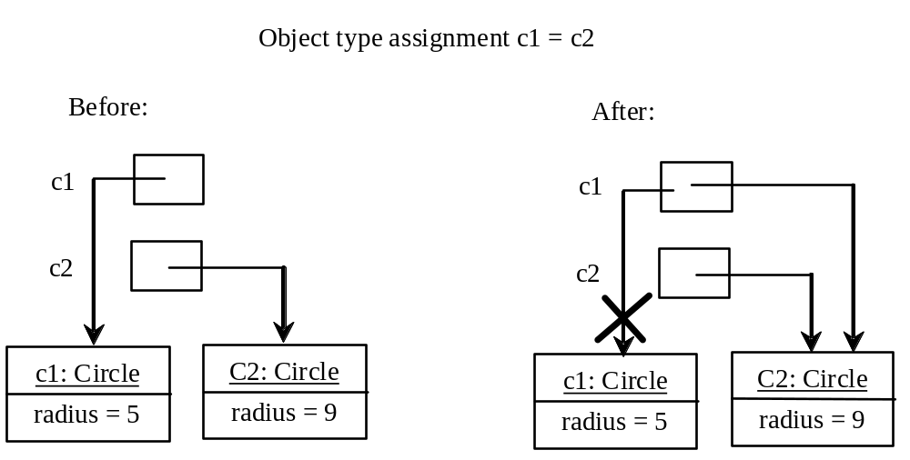
Copying Variables of Primitive Data Types and Object Types

Slide 21
Garbage Collection
As shown in the previous figure, after the assignment statement c1 = c2, c1 points to the same object referenced by c2. The object previously referenced by c1 is no longer referenced. This object is known as garbage. Garbage is automatically collected by JVM.
If you know that an object is no longer needed, you can explicitly assign null to a reference variable for the object. The JVM will automatically collect the space if the object is not referenced by any variable.

Slide 22
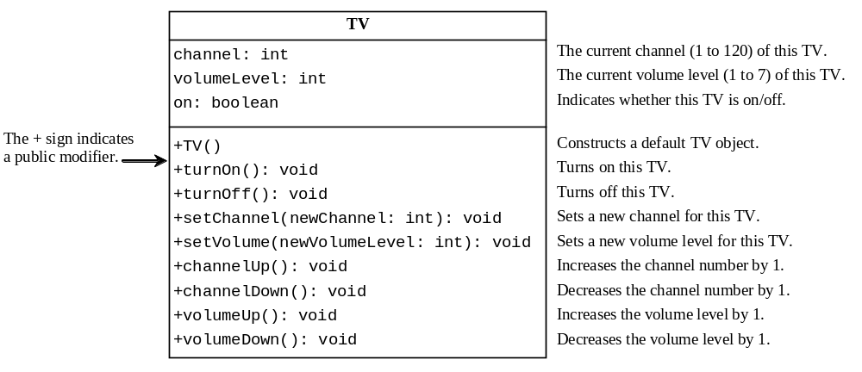
Example: Defining Classes and Creating Objects
TV
TestTV
Run

Slide 23

The Date Class
We previously learned to use the System.currentTimeMillis() to obtain the current time.
Java also provides a built-in Date class to create an instance for the current date and time and use its toString method to return the date and time as a string.

Slide 24
The Date Class Example
For example, the following code
  java.util.Date date = new java.util.Date();
  System.out.println(date.toString());
displays a string like Mon Mar 21 13:59:19 EDT 2016.

Slide 25

The Random Class
You have used Math.random() to obtain a random double value between 0.0 and 1.0 (excluding 1.0). Another way to generate random numbers is to use the java.util.Random class.
To specify range: Random().nextInt(max - min + 1) + min

Slide 26
The Random Class Example
If two Random objects have the same seed, they will generate identical sequences of numbers. For example, the following code creates two Random objects with the same seed 3.
Random random1 = new Random(3);
System.out.print("From random1: ");
for (int i = 0; i < 10; i++)
System.out.print(random1.nextInt(1000) + " ");
Random random2 = new Random(3);
System.out.print("\nFrom random2: ");
for (int i = 0; i < 10; i++)
System.out.print(random2.nextInt(1000) + " ");
From random1: 734 660 210 581 128 202 549 564 459 961
From random2: 734 660 210 581 128 202 549 564 459 961

Slide 27
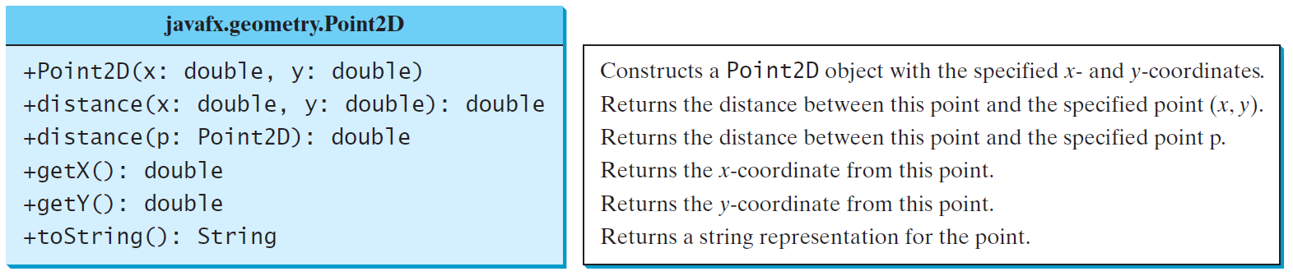
The Point2D Class
Java has a convenient Point2D class in the javafx.geometry package for representing a point in a two-dimensional plane.
The class provides several methods, see online documentation for details.

Slide 28

The Point2D Class
Point2D p1 = new Point2D(2, 3);
Point2D p2 = new Point2D(4, 5);
System.out.println("p1 is " + p1.toString());
System.out.println("Distance between p1 and p2: " + p1.distance(p2));
System.out.println("Distance between p1 and p2: " + p1.distance(4, 5));
System.out.println("Midpoint between p1 and p2: " + p1.midpoint(p2));
System.out.println("x-coordinate of midpoint: " + p1.midpoint(p2).getX());

Slide 29
Instance vs. Static Variables and Methods
Instance variables belong to a specific instance whereas static variables are shared by all the instances of the class.
Instance methods are invoked by an instance of the class whereas the static methods are invoked using the class name.
To declare static variables and methods, use the static modifier.

Slide 30
Example of
Using Instance and Class Variables and Method
Objective: Demonstrate the roles of instance and class variables and their uses. This example adds a class variable numberOfObjects to track the number of Circle objects created.
CircleWithStaticMembers
TestCircleWithStaticMembers
Run

Slide 31
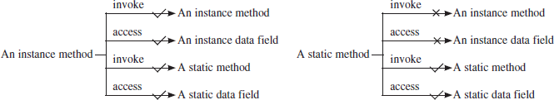
Instance vs. Static Methods

Slide 32
Instance vs. Static Methods
The following code is wrong.
public class A {
int i = 5;
static int k = 2;
public void m1() {
// Correct since instance method can access instance and static variables and methods
i = i + k + m2(i, k);
}
public static int m2(int i, int j) {
return (int)(Math.pow(i, j));
}
public static void main(String[] args) {
int j = i; // Wrong because i is an instance variable
m1(); // Wrong because m1() is an instance method
}
}

Slide 33
Instance vs. Static Methods
The following code is correct.
public class A {
int i = 5;
static int k = 2;
public static void main(String[] args) {
A a = new A();
int j = a.i; // i can now be accessed using the instance a
a.m1(); // m1 can now be invoked using the instance a
public void m1() {
// Correct since instance method can access instance and static variables and methods
i = i + k + m2(i, k);
}
public static int m2(int i, int j) {
return (int)(Math.pow(i, j));
}
}

Slide 34
When to use Instance vs. Static Methods
One rule-of-thumb: ask yourself "does it make sense to call this method, even if no instance has been constructed yet?" If so, it should definitely be static.
So in a class Car you might have a method double convertMpgToKpl(double mpg) which would be static, because one might want to know what 35mpg converts to, even if nobody has ever built a Car.
But void setMileage(double mpg) (which sets the efficiency of one particular Car) can't be static since it's inconceivable to call the method before any Car has been constructed.
Besides, static methods cannot be overridden. If overriding is needed, use instance methods.

Slide 35
Visibility Modifiers and
Accessor/Mutator Methods
By default, the class, variable, or method can be
accessed by any class in the same package.
public
The class, data, or method is visible to any class in any package.
private
The data or methods can be accessed only by the declaring class.
The get (accessor) and set (mutator) methods are used to read and modify private properties.

Slide 36


The private modifier restricts access to within a class, the default modifier restricts access to within a package, and the public modifier enables unrestricted access.

Slide 37
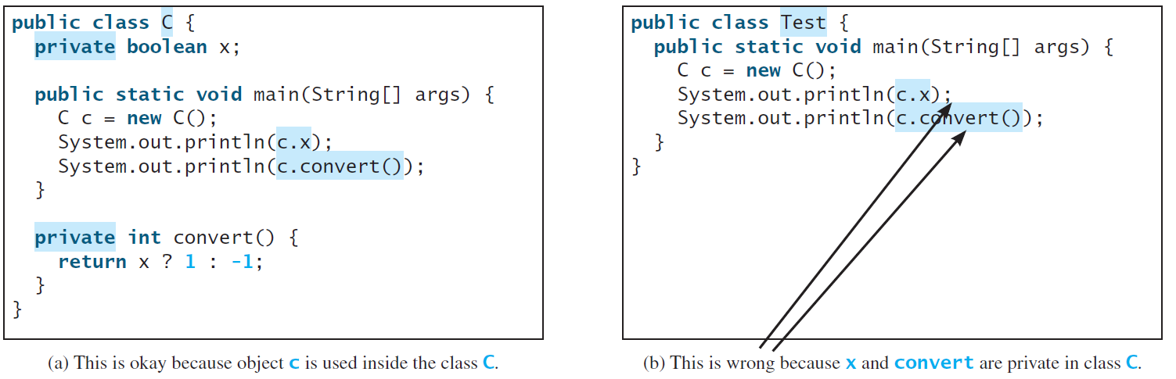
NOTE
An object cannot access its private members, as shown in (b). It is OK, however, if the object is declared in its own class, as shown in (a).

Slide 38

Data Field Encapsulation
To prevent direct modifications of data fields, declare the data fields private. This is known as data field encapsulation.
To make the private data field accessible, provide a getter method and to enable a data field to be updated, provide a setter method.
CircleWithPrivateDataFields
TestCircleWithPrivateDataFields
Run

Slide 39
Data Field Encapsulation
Now you may be wondering – well, we make a data field private and then provide get and set methods to access and update the data field. Why not just make the data field public?

Slide 40
Data Field Encapsulation
Now you may be wondering – well, we make a data field private and then provide get and set methods to access and update the data field. Why not just make the data field public?
It's important to remember that we want to hide the data of the object as much as possible. The get and set methods allow us to
  impose validation on the values of the data field (for instance in set method, we can specify that the radius cannot take a negative value)
  change how the data is handled behind the scene (for instance, let’s say we decide to change radius from double to string. The user need not be worried, you can take care of the conversion from double to string in the set method using Double.toString() method and from string to double in the get method using Double.parseDouble() method)

Slide 41
Data Field Encapsulation
public class Circle {
private double radius;
public double getRadius() {
return radius;
}
public void setRadius(double r) {
radius = r;
}
}
public class Circle {
private String radius;
public double getRadius() {
return Double.parseDouble(radius);
}
public void setRadius(double r) {
radius = Double.toString(r);
}
}

Slide 42
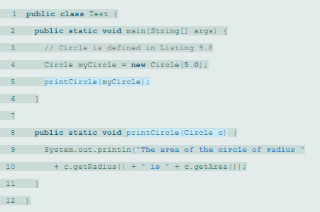
Passing Objects to Methods
Like passing an array, passing an object is actually passing the reference of the object.
Java uses exactly one mode of passing arguments: pass-by-value. In the preceding code, the value of myCircle is passed to the printCircle method. This value is a reference to a Circle object.

Slide 43

Array of Objects
Circle[] circleArray = new Circle[10];
Invoking circleArray[0].getArea() involves two levels of referencing.
circleArray references to the entire array. circleArray[0] references to the first Circle object.
TotalArea
Run

Slide 44
Immutable Objects and Classes
If the contents of an object cannot be changed once the object is created, the object is called an immutable object and its class is called an immutable class.
The string class, for instance, is immutable.
If you delete the set method in the Circle class in the link below, the class would be immutable because radius is private and cannot be changed without a set method.
CircleWithPrivateDataFields
TestCircleWithPrivateDataFields

Slide 45
Example
class Student {
  private int id;
  private String name;
  private java.util.Date dateCreated;
  public Student(int ssn, String newName) {
  id = ssn;
  name = newName;
  dateCreated = new java.util.Date();
  }
  public int getId() {
  return id;
  }
  public String getName() {
  return name;
  }
  public java.util.Date getDateCreated() {
  return dateCreated;
  }
}
A class with all private data fields and without mutators is not necessarily immutable.
For example, the following class Student has all private data fields and no mutators, but it is mutable.
public class Test {
public static void main(String[] args) {
Student student = new Student(101, "John");
java.util.Date dCreated = student.getDateCreated();
dCreated.setTime(200000); // dateCreated field is changed!
System.out.println(student.getDateCreated());
}
}

Slide 46
What Class is Immutable?
All data fields must be private
There can’t be any mutator methods for data fields
No accessor methods can return a reference to a mutable data field object.
So, in our previous example, instead of returning a reference to the data object, return a copy of the data object.
public java.util.Date getDateCreated() {
return (java.util.Date) dateCreated.clone();
}

Slide 47
Scope of Variables
The scope of class variables (instance and static) is the entire class. They can be declared anywhere inside a class. They also have default values as discussed previously.
The scope of a local variable starts from its declaration and continues to the end of the block that contains the variable. A local variable must be initialized explicitly before it can be used.

Slide 48
Scope of Variables
If a local variable has the same name as a class’s variable, the local variable takes precedence and the class’s variable with the same name is hidden.
public class F {
private int x = 10; // Instance variable
private int y = 5;
public F() {
}
public void p() {
int x = 1; // Local variable
System.out.println("x = " + x);
System.out.println("y = " + y);
}
}

Slide 49
The this Keyword
The this keyword is the name of a reference that refers to an object itself.
One common use of the this keyword is reference a class’s hidden data fields.
Another common use of the this keyword to enable a constructor to invoke another constructor of the same class.

Slide 50

The this Keyword - Example

